Slide 1
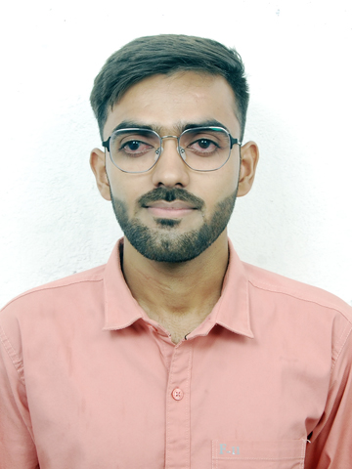
Ankit Rajput
Professional Experience
2.7 years of professional experience with 2+ years of experience as a dedicated and results-oriented SAP Fiori Analyst with a strong background in custom Fiori Element reports. Proficient in a wide range of technologies, including SAP S/4 Hana and CDS based custom Fiori Reports
• Strong problem-solving abilities, with a focus on writing clean, maintainable, and well-documented code.
• Experienced in working and collaborating with teams.
• Writing and execution unit test cases.
• Basic knowledge on SAP BTP.
• Basic knowledge on SAP BW/4 Hana (AFO and WebI Reports)
• Experienced in monitoring Batch jobs and Process chains.
Tools & Technology:
Eclipse, SAP Hana Studio , SAP GUI, BOBJ, ABAP Development Tool (ADT), WebID,
SAP Business Technology Platform (BTP), My SQL
EMAIL: ankirajput@deloitte.com
Qualifications
Key Engagements
BTech: Oriental Institute of Science and Technology
Worked with North America based Retail client as a SAP Fiori Analyst
Worked on custom Fiori reports.
Created custom reports using CDS views, annotations.
Collaborate with Business Analyst and end users to understand requirement.
Created technical specification and functional documents for client requirements.
Actively involved in code reviews and technical design discussions with leads.
Providing the support for the project by handling daily tasks and incidents.
Worked on CDS based BOBJ reports.
Providing support in monitoring and handling of daily running Batch jobs and process chains.
Primary skills
SAP Fiori
S/4 Hana
CDS Views
ABAP Development Tool
My SQL
BW/4 Hana

